Slide 1
M.Sc. In Information Engineering for Digital Medicine
Design and implementation of a wearable device for continuous, non-invasive blood pressure measurement
STUDENT
ADVISORS
Verolla Luigi
0623200002
Giaquinto Martino
Carletti Vincenzo

Slide 2
1
Context and State-of-art approaches
2
Signal preprocessing
3
Features analysis
4
Segmentation
5
Experiments

Slide 3
Context and State-of-art approaches
ABP and PPG signals, the MIMIC-II Waveform Dataset

Slide 4
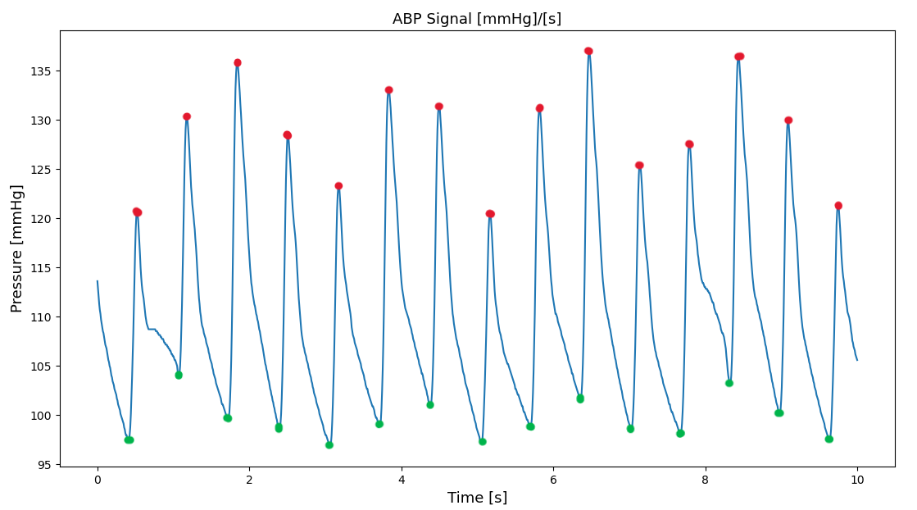
1
Context introduction
The ABP signal (Arterial Blood Pressure)
Measured with invasive techniques (pressure sensor installed inside artery)
Peaks are systolic BP values, valleys are diastolic BP values
SBP and DBP are the ground truth values

Slide 5
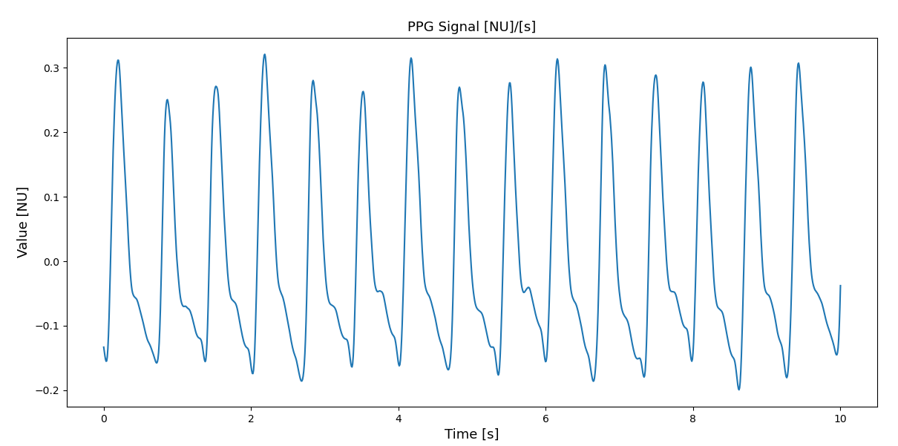
1
Context introduction
The PPG signal (PhotoPlethysmoGraph)
Measures the changes in light absorption caused by the variation of blood volume over time
Value is dimensionless (NU = numerical units)
From PPG, feature will be extracted

Slide 6
1
Context introduction
Similarity between ABP and PPG
Shape is almost the same
ABP almost clean, PPG noisier
No known correlation
Peaks and valleys match
Both follows heart rate
ABP measured inside arthery
No mathematical model or relationship
Statistical approaches and machine learning needed
PPG measured on body surface (fingertip, wrist, earlobe)

Slide 7
1
Context and State-of-art approaches
Common aspects
Cuff-based ABP measurement as ground truth
All BP values expressed in mmHg
AAMI and BHS validation standards
MAE ± STD as error metric
MIMIC as most used dataset

Slide 8
2
State-of-art approaches
Common pipeline
Data preprocessing
Feature extraction
Feature selection (when necessary)
Experiments and train
Testing (on PC or Embedded systems)
Segmentation

Slide 9
2
State-of-art approaches
Data Preprocessing
Filtering
SW filters
HW based [12] [19]
Segmentation
Time-based
pulse-based
Signal normalization
Min-max
Z-score [5]
Outlier removal
Interquartile range
Mean and standard deviation
By hand

Slide 10
2
State-of-art approaches
Feature extraction and selection
Which features?
Time domain
Frequency domain [2] [5] [6] [7] [8] [11]
Patients’ demographics [5] [6] [8] [10] [14]
From which signals?
PPG signal
PPG I and II derivative [6] [11] [13]

Slide 11
2
State-of-art approaches
Feature extraction
Statistic
MIV [3]
MIC [4] [7]
Collinearity [7]
PCC [7] [8]
Iterative
ReliefF [5]
Forward selection [8]
Recursive elimination [8]
ML approaches
Linear SVM [10]
RF importance [8]

Slide 12
2
State-of-art approaches
Experiments and train
Statistic regression
Linear [4] [8] [9] [19]
Polynomial [12] [19]
Gaussian process [5]
Lasso [6]
ML approaches
RBF SVR [3] [7] [9] [10]
Linear SVR [19]
non-linear SVR [13]
Random forest [19]
ANN [1] [8] [11] [14] [15] [18]
Deep learning appraches
CNN [2] [17] [20]
RNN [1] [8] [16] [20]
Validation
K-fold
Leave-one-out [12]

Slide 13
2
State-of-art approaches
Testing
On PC
On MCU
32-bit MCU [1] [17] [18] [19] [20]
16-bit MCU (only regression) [12]
Smartphone [6]
No test, validation only [10] [12] [14] [15]
With test set [most papers]

Slide 14
2
State-of-art approaches
Critical aspects
Measurement errors or biases
PPG measurement on the same arm w.r.t to cuff-based measurement [1]
BP measured only with patient in static/supine position
Interpolation (to match higher sampling frequencies) may lead to errors [10]
Dependency between train and test set
Train and test set must contain data from different patients, to avoid similarities
No paper specifies the split criteria
Incorrect feature normalization
Must be performed after split on both set with data only from train set
Not always clear if this rule is followed [1]
Small datasets
Small number of patients = small variance in data
Model will not be able to generalize on new different samples

Slide 15
2
State-of-art approaches
State-of-art summary: legend
General indications
A dash (-) indicates that the relative detail/parameter isn’t specified in the paper
In case of training with more configuration, only the parameters that gave the best results are reported
Techical specifications
If known, the sampling frequency of the dataset and sensor (if has an embedded ADC) is reported
Sensor acquisition modality (analogue, I2C, SPI,…) is reported
Number of signals is for each patient, counted before split
Reported number of features is after eventual selection
Splits are indicated as «train/validation/test» percentages of dataset
«MCU» indicates acquisition or testing with MCU

Slide 16
2
State-of-art approaches
State-of-art summary
 | Dataset | Sensors | Preprocessing | Segment | Features | Models | Errors
[1] MCU | MIMIC-II - 125 Hz 40 patients 2min signals | SEN-11574 analogue | 0.5-5 Hz BP filter Min-max norm | 1 cardiac cycle | 5 time | LSTM + ANN 80/0/20 split | SBP MAE 3.39 ± 5.47 DBP MAE 1.79 ± 3.72
[4] | Queensland - 100 Hz 32 patients 15min-5h signals | None | 0.7-3 Hz BP filter | - | 5 time | Linear regression 50/0/50 split | SBP MAE 0.78 ± 13.1 DBP MAE 0.59 ± 10.2
[5] | Unknown - 1kHz 219 patients ~2s signals | SEP9AF-2 analogue | 25 Hz LP filter Baseline removal Z-score norm | Whole signal | 21 time, demographics | GP regression 85/0/15 split | SBP MAE 3.02 ± 9.29 DBP MAE 1.74 ± 5.54
[6] | Self-made - 125 Hz 205 patients 15min signals | phone sensor | Filter not specified Min-max norm | 15s | 233 time, frequency | Lasso regression 78/0/22 split | SBP MAE 6.9 ± 9.0 DBP MAE 5.0 ± 6.1
[7] | Queensland 32 patients | None | Wavelet denoising Average filters | 10s | 18 Time, frequency | RBF SVR 80/0/20 split | SBP MAE 4.63 ± 7.43 DBP MAE 3.29 ± 5.09

Slide 17
2
State-of-art approaches
State-of-art summary
 | Dataset | Sensors | Preprocessing | Segment | Features | Models | Errors
[8] | MIMIC-II - patients 500 waveforms | None | Savitzky-Golay filter, Min-max normalization, ABP/PPG synchronization | 7s | 22 Time, frequency Min-max normalization | GRU RNN 60/20/20 split | SBP MAE 2.58 ± 3.35 MBP MAE 1.26 ± 1.63
[10] | Self-made 65 patients 78 waveforms | Phone camera, Oxymeter | DWT transform | - | 12 (SBP), 21 (DBP) Gender, DWT coefficients | RBF SVR -/-/- split | SBP MAE 4.9 ± 4.9 DBP MAE 4.3 ± 3.7
[11] | MIMIC-II 125 Hz - patients 3000 waveforms | phone sensor | No filtering specified | - | 46 Time, Frequency, derivatives | ANN regressor 80/0/20 split | SBP MAE 4.47 ± 6.85 DBP MAE 3.21 ± 4.72
[13] | MIMIC-II – 125 Hz - patients 910 waveforms | None | LP filter (cutoff not specified) | - | 35 Time, derivatives | Non-linear SVR 70/0/30 split | SBP MAE 8.54 ± 10.9 DBP MAE 4.34 ± 5.8
[15] | Unknown Patients 40 waveforms | - | 0.5-30 Hz BP filter | - | 4 time | ANN regressor 10-fold CV | SBP MAE 0.17 ± 3.9 DBP MAE 0.3 ± 1.8

Slide 18
2
State-of-art approaches
State-of-art summary
 | Dataset | Sensors | Preprocessing | Segment | Features | Models | Errors
[17] MCU | MIMIC-II (train) - patients Self-made (test) 8 patients 125 Hz, 2min signals | - | 6 Hz LP filter 0.5 Hz HP filter Min-max normalization | - | 4 time | CNN autoencoder No split | SBP MAE 2.25 ± 2.82 DBP MAE 5.01 ± 2.10
[18] MCU | MIMIC-III – 125 Hz 47 patients | VD6283TX I2C 62.5 Hz | 0.5-7 Hz BP filter | 1 beat | Signal samples | ANN regressor No split | SBP MAE 3.85 ± 4.29 DBP MAE - ± -
[22] MCU | Self-made – 1kHz 8 patients | multiPANI analogue | Wavelet decomposition, Moving average filter | 2 min | 6 time | Linear regression No split | SBP RMSE+MAD 3.94 +- 2.91 DBP RMSE+MAD 1.88 ± 1.42
[23] MCU | Self-made 15 patients | MAX30102 400 MHz I2C MEMS accelerometer (BCG) | 50 Hz LP filter 30 Hz LP filter | 1 cardiac cycle | 30 PPG+BCG | Linear regressor No split | SBP MAE 3.08 ± - DBP MAE 1.52 ± -

Slide 19
Preprocessing
Denoising, baseline removal, segmentation and signal selection

Slide 20
3
Preprocessing
Outline
The MIMIC-II Waveform Dataset
Issues with raw PPG signals
Wavelet decomposition as filter
Segmentation and peak detection
Signal selection
Feature extraction

Slide 21
3
Preprocessing
The MIMIC-II Waveform Dataset
Public dataset with medical-related waveforms
Blood pressure (ABP), PPG, Electrocardiogram (ECG), and others
The Matched Subset [25] is used
Records linked to entries the MIMIC-II Clinical Dataset
Gaps or constant signals due to interruption/anomalies of acquisition devices
Not all records are of the same length
Some signals are missing in some of the records
Developed by Physionet [26], a repository managed by MIT
Data cleaning stage needed

Slide 22
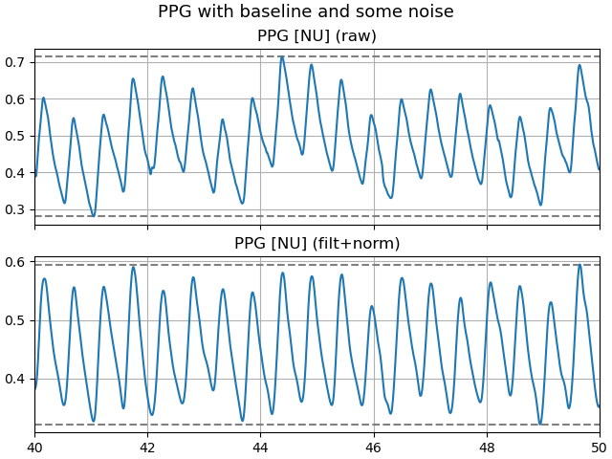
3
Preprocessing
Issues with PPG signal
PPG is very sensible to movement and displacement of sensor may lead to unusable records
high-frequency components (noise): motion and ambient light
low-frequency components (baseline): respiration

Slide 23
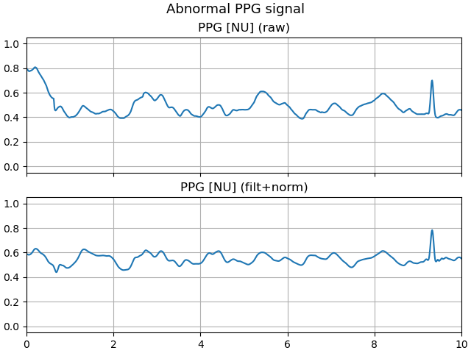
3
Preprocessing
Abnormal PPG signal

Slide 24
3
Preprocessing
Analysis by Wavelet Decomposition
Decompose signal’s band $B$ into sub-bands
Decompose signal’s band 𝐵 into sub-bands
$N$ filtering levels generate sub-bands of $B/{2^{N}}$
𝑁 filtering levels generate sub-bands of 𝐵∕2^𝑁
Recursive division
Divide band in approximation and detail
Subsequent divisions on approximation
Time/frequency representation
Ideal for frequency components present locally in the signal
Heatmap-like representation: Spectrogram

Slide 25
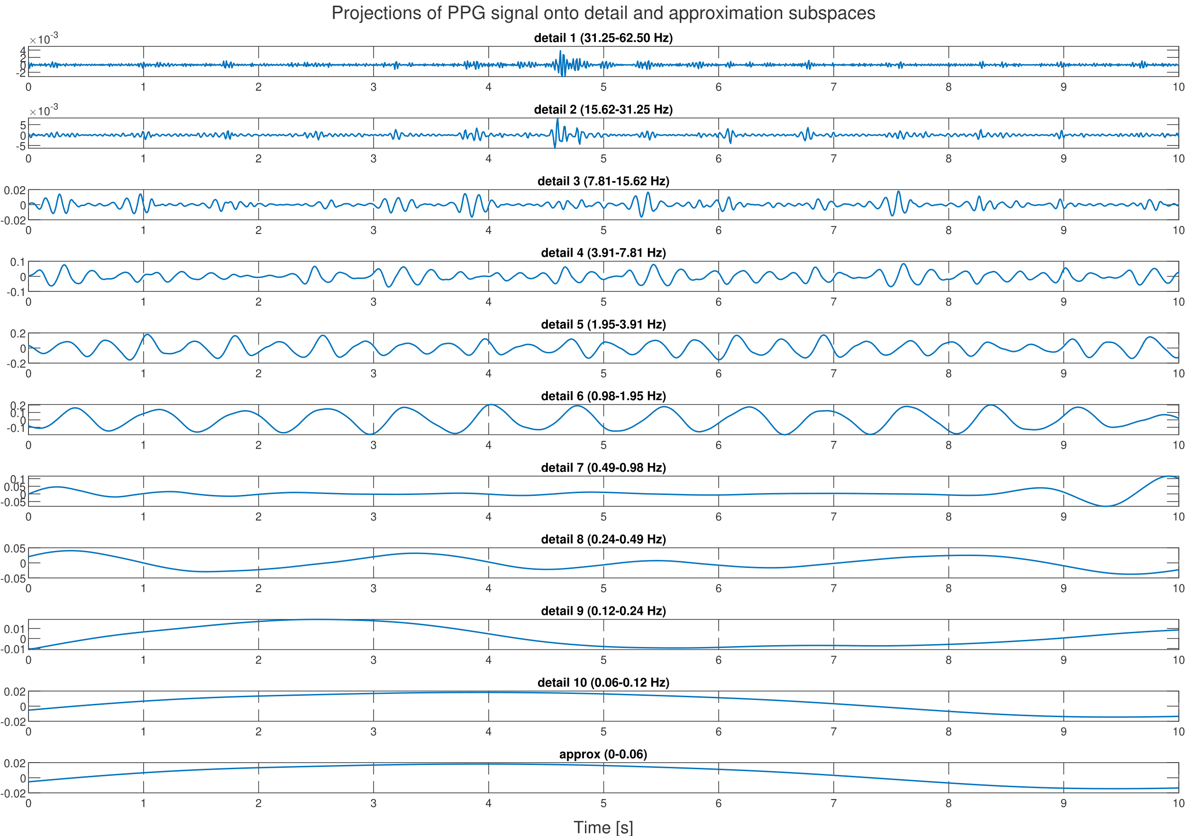
3
Preprocessing

Slide 26
3
Preprocessing
Result of analysis
Some bands bring information…
Slice 6 (1-2 Hz) brings the information about heartbeats
Slice 5 (2-3 Hz) is the one responsible for the dicrotic notch
Feature extracted on slices 5 and 6
No need to reconstruct the whole signal
No interference from other bands
…while others are not related
Higher slices (3.91-62.5 Hz) seem periodic and may bring some information
Slice 8 (0.2-0.5 Hz) seems to contain the respiration signal

Slide 27
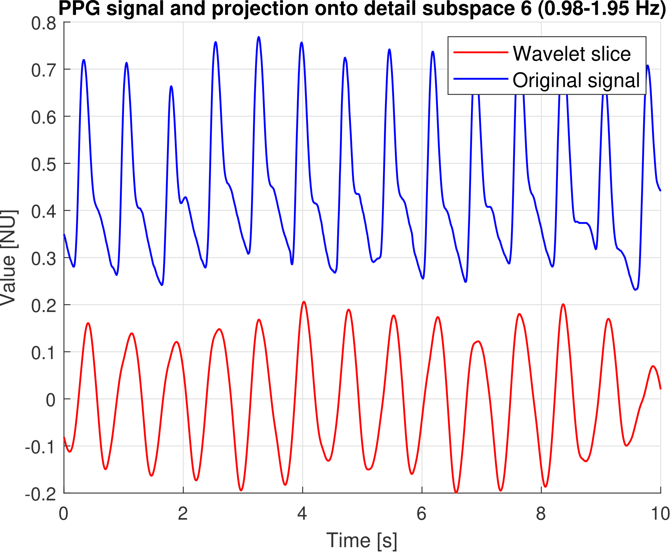
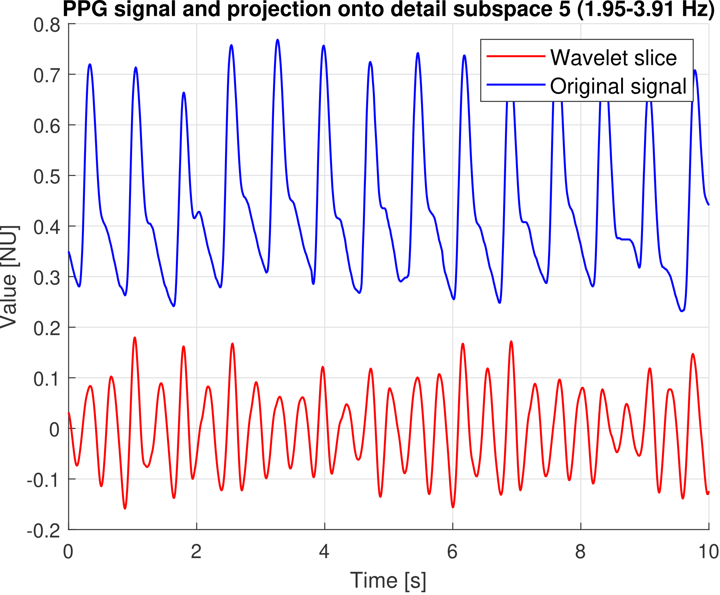
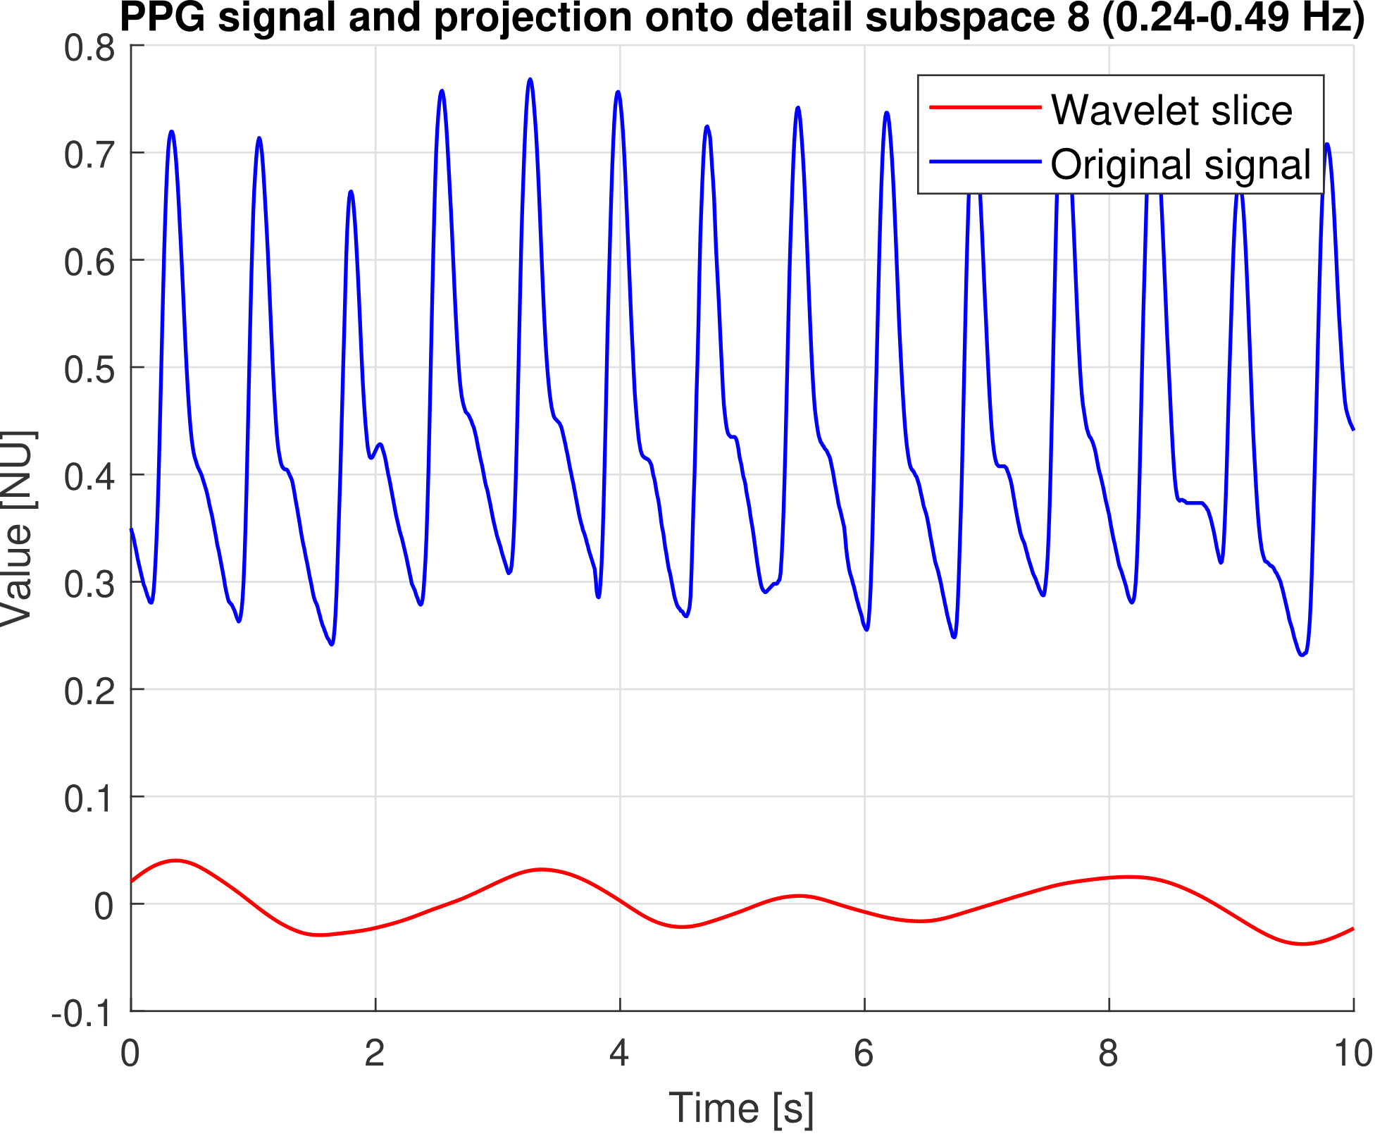
3
Preprocessing
Beats, notches and respiration

Slide 28
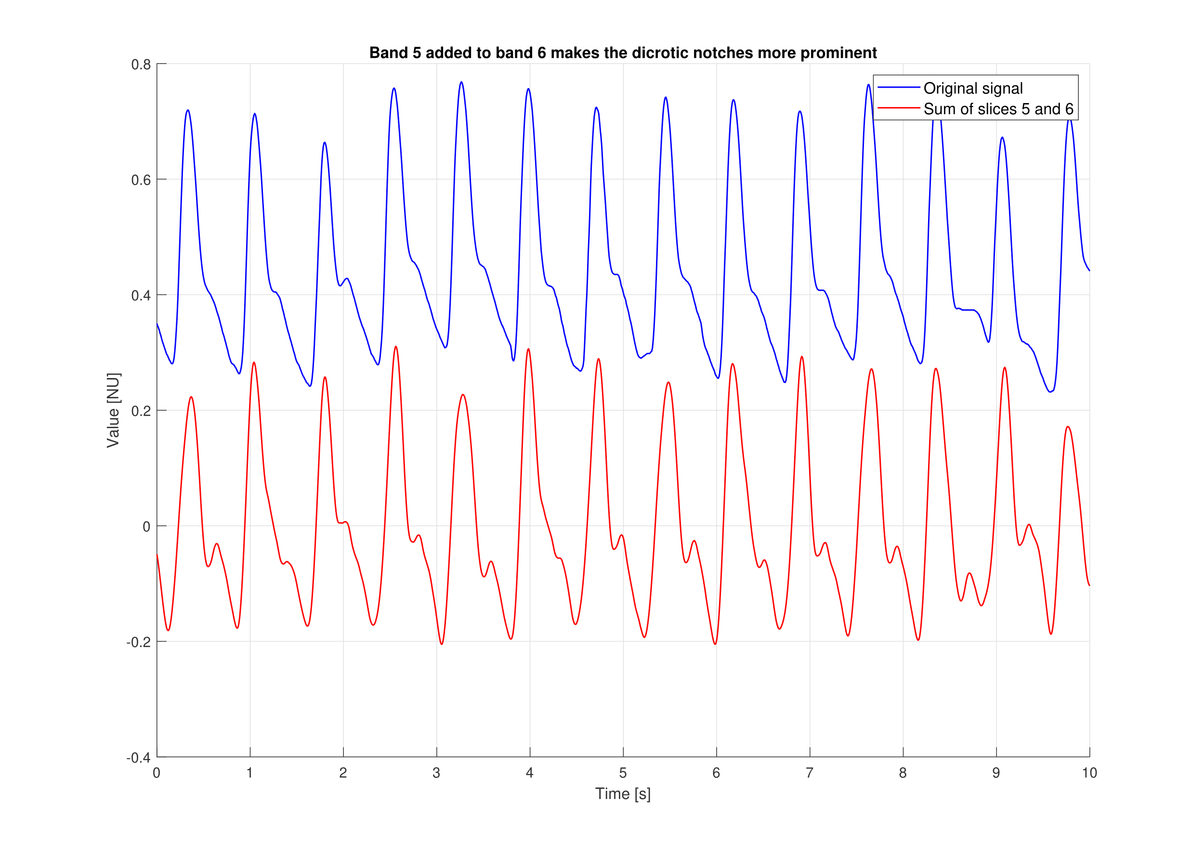
3
Preprocessing

Slide 29
3
Preprocessing
Segmentation and peak detection
Segmentation with different window sizes and overlaps
Peak detection with adaptive threshold using custom algorithm
Valley detection as minimum point between two near peaks

Slide 30
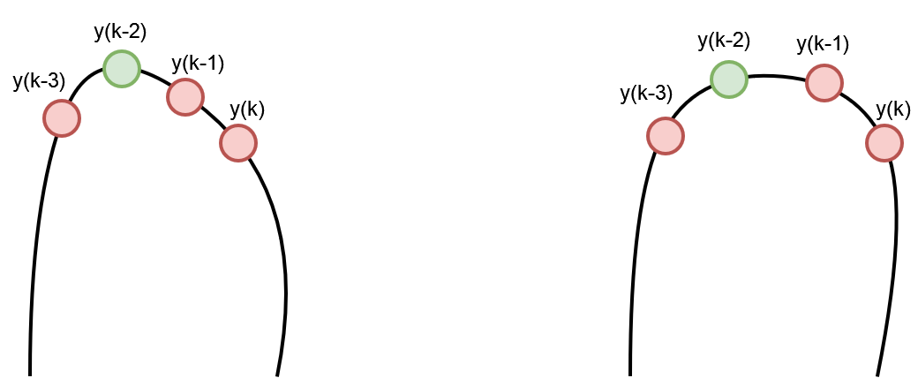
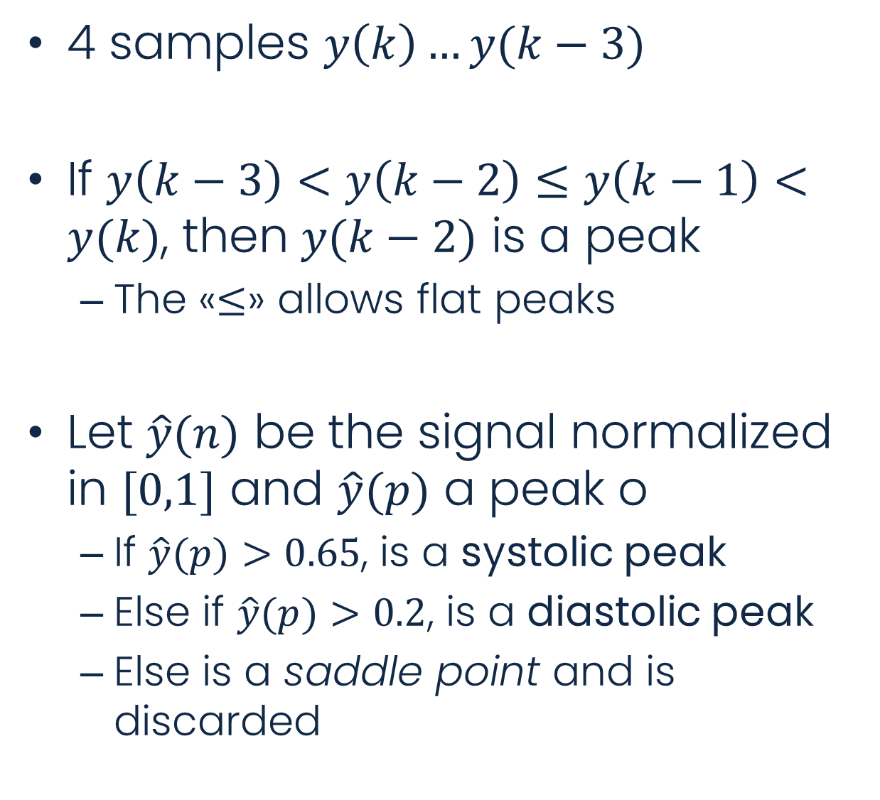
3
Preprocessing
Peak detection algorithm
4 samples $y\left(k\right)…y(k−3)$
If $y\left(k−3\right)<y\left(k−2\right)≤y\left(k−1\right)<y(k)$, then $y(k−2)$ is a peak
The «$≤$» allows flat peaks
Let $\hat{y}(n)$ be the signal normalized in $[0,1]$ and $\hat{y}(p)$ a peak o
If $\hat{y}(p)>0.65$, is a systolic peak
Else if $\hat{y}(p)>0.2$, is a diastolic peak
Else is a saddle point and is discarded

Slide 31
3
Preprocessing
Signal selection
«good» and «bad» signals differ in shape
Location in time of peak/valleys and their value range
Normalisation of signal windows
Heights of points don’t affect the shape, difference between them does
Median among measures
Extraction of peaks/valleys-related metrics
Time and height differences between subsequent peaks/valleys
Total number of peaks in window
We tolerate that half of the metrics’s values doesn’t meet thresholds

Slide 32
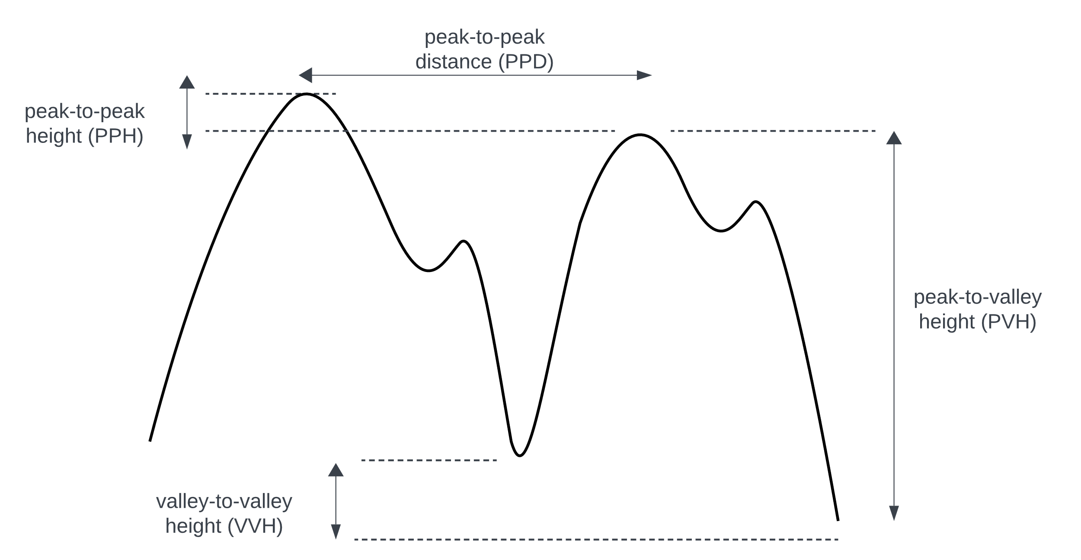
3
Preprocessing
Signal selection metrics

Slide 33
3
Preprocessing
Signal selection metrics
Distance metrics linked to heart rate
HR is measured in bpm and 1 bpm = 60 Hz
Number of peaks should be HR/60, but we allow some missing peaks
Distance between peaks should be 60/HR
Height metrics linked to signals’ quality
«Perfect» signal has all peaks = 1 and all valleys = 0
PPG and ABP signals comes from sensors and are not perfect
Trade-off for height metrics’ thresholds
«Fluctuations» may affect features’ computation
High threshold = good signals but too many will be discarded
After various attempts, PVH >= 0.7 and VVH = PPH <= 0.3 are good values

Slide 34
Feature analysis
Feature extraction, selection and both univariate and multivariate analysis

Slide 35
4
Feature analysis
Feature extraction
Time-related features
Distances between fiducials and pulse width at fraction of amplitude
Median as chosen value
Each window yields more values of same feature (more pulses -> more fiducials)
Mean not suitable because no assumption of normal distribution
Independent and dependent
Dependent features are interactions (such as division) of independent features
Extracted on signal composed of band slices 5 and 6

Slide 36
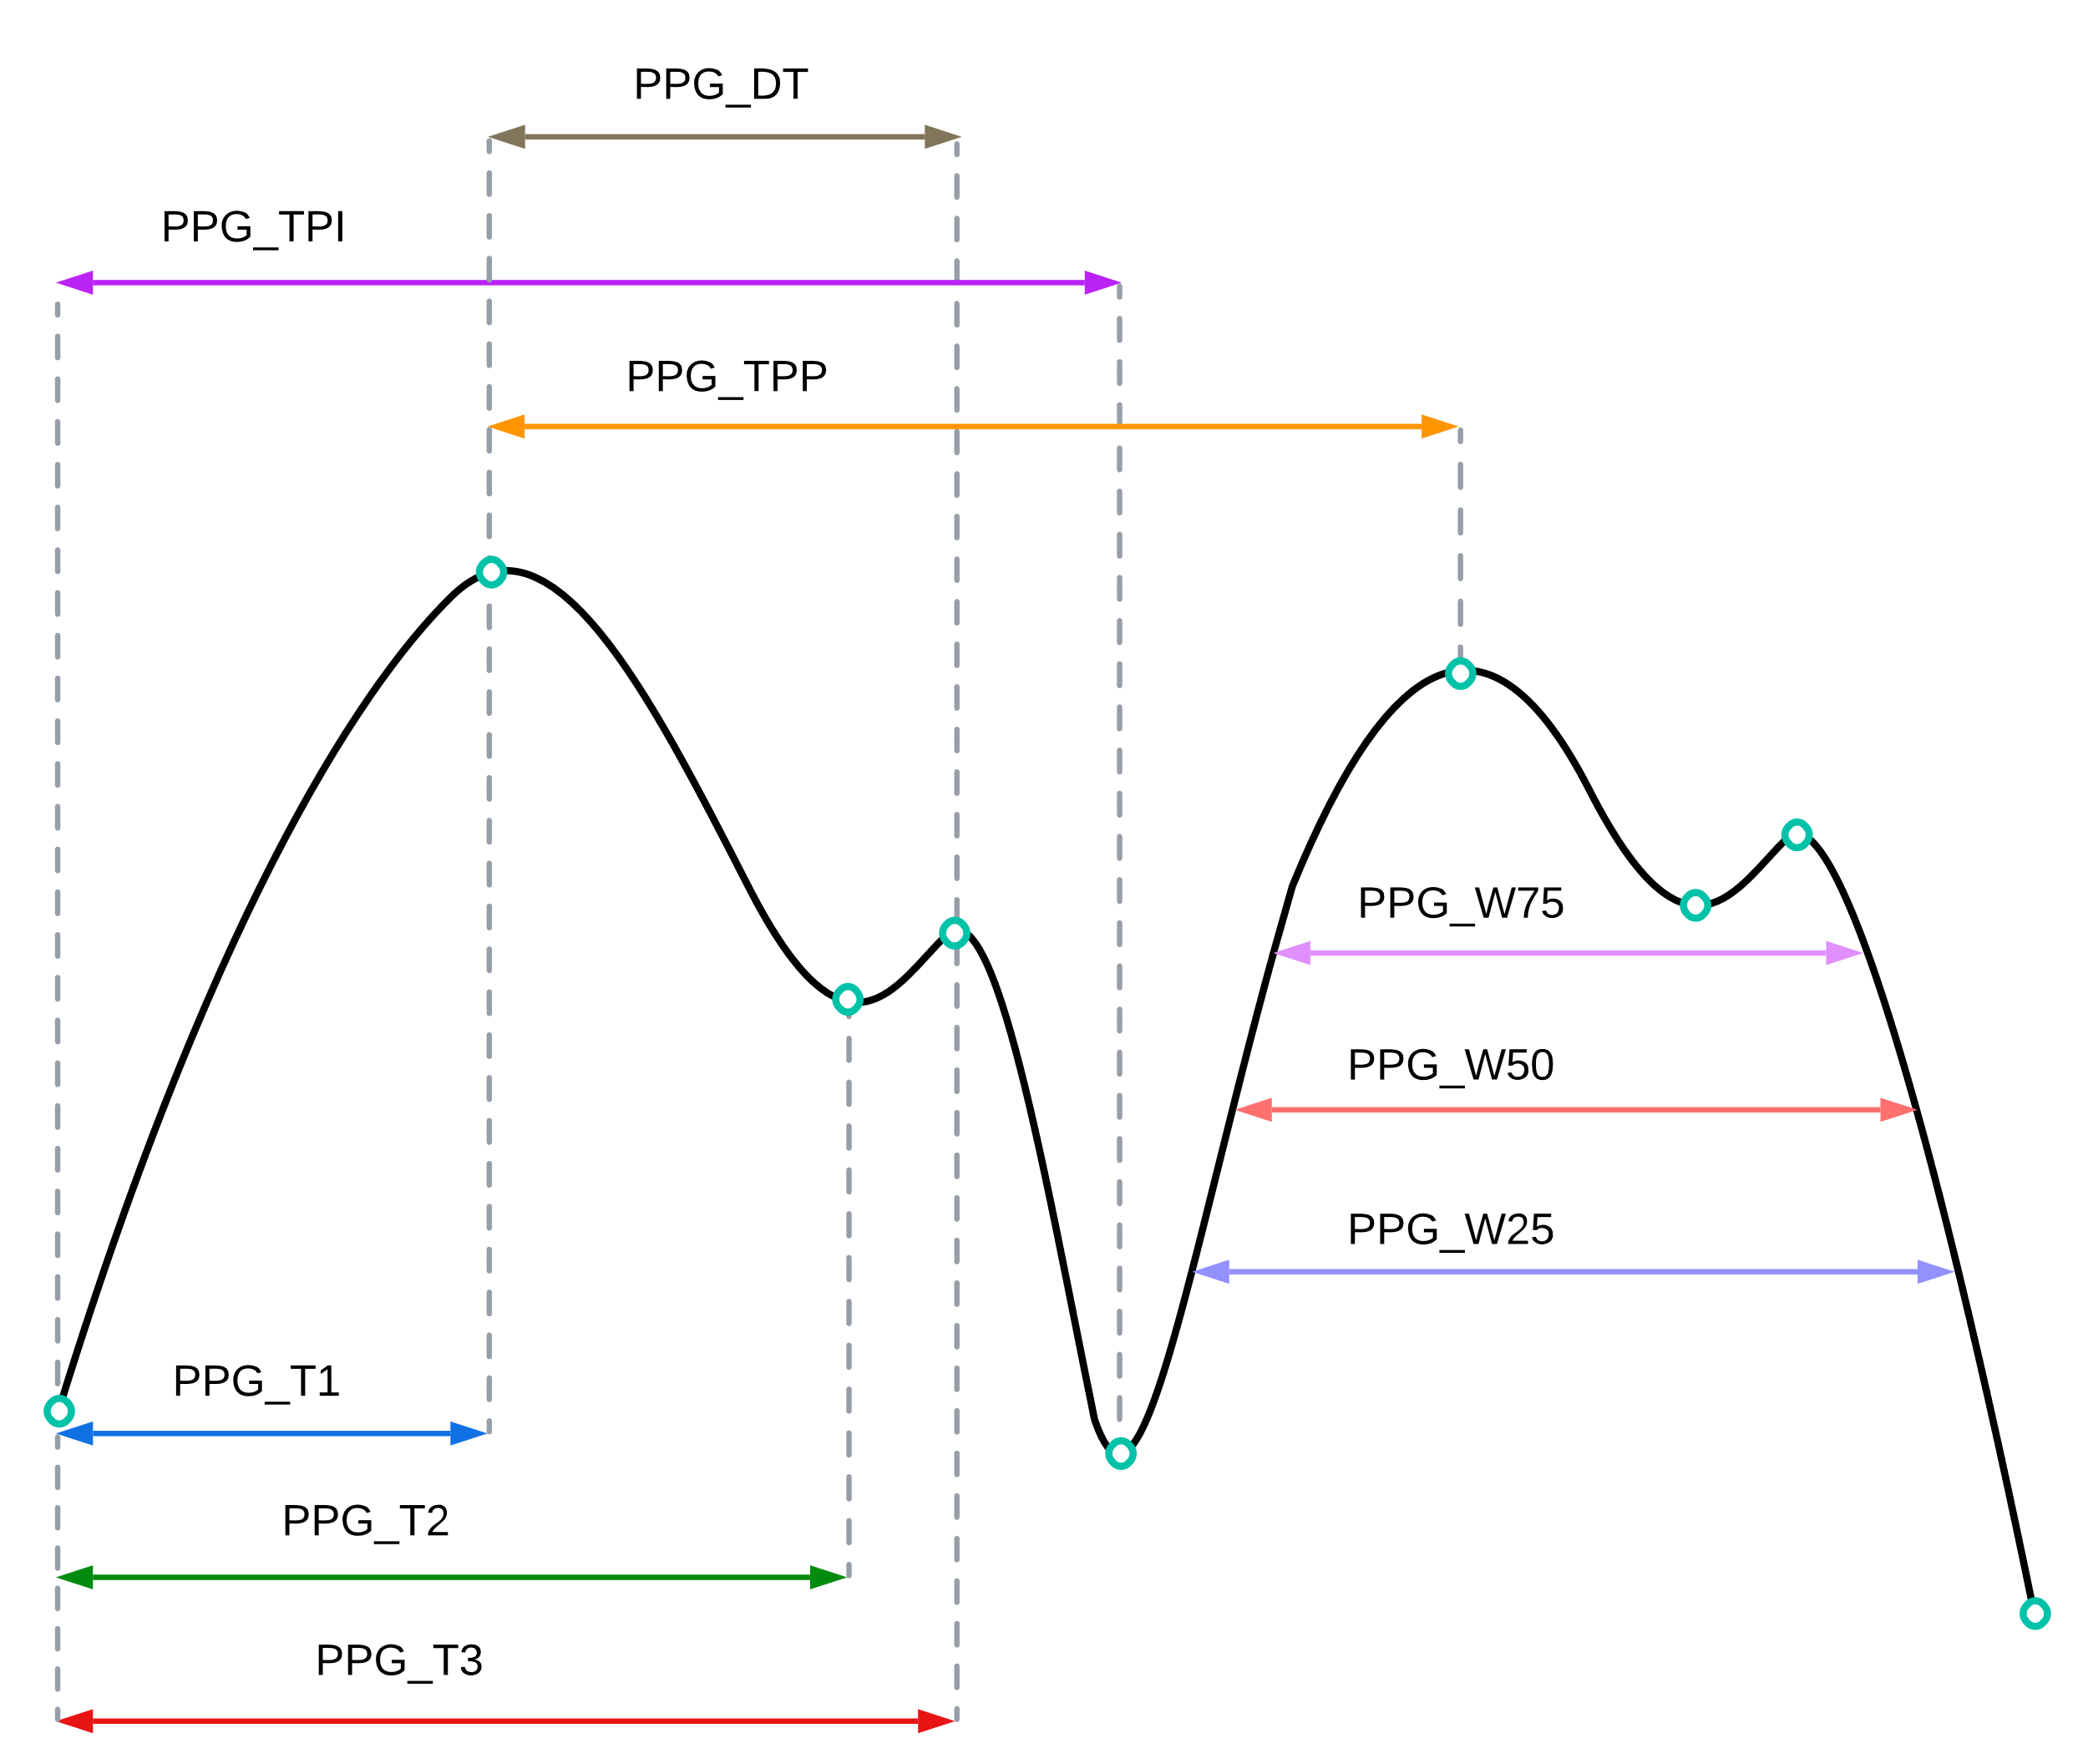
4
Feature analysis
Features

Slide 37
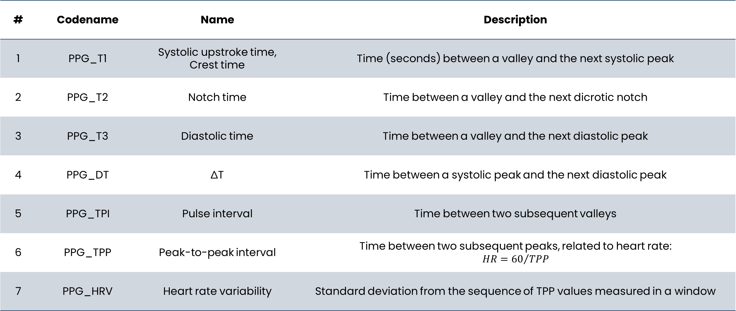
4
Feature analysis
Features
# | Codename | Name | Description
1 | PPG_T1 | Systolic upstroke time, Crest time | Time (seconds) between a valley and the next systolic peak
2 | PPG_T2 | Notch time | Time between a valley and the next dicrotic notch
3 | PPG_T3 | Diastolic time | Time between a valley and the next diastolic peak
4 | PPG_DT | ∆T | Time between a systolic peak and the next diastolic peak
5 | PPG_TPI | Pulse interval | Time between two subsequent valleys
6 | PPG_TPP | Peak-to-peak interval | Time between two subsequent peaks, related to heart rate: $$HR={60}/{TPP}$$
7 | PPG_HRV | Heart rate variability | Standard deviation from the sequence of TPP values measured in a window

Slide 38
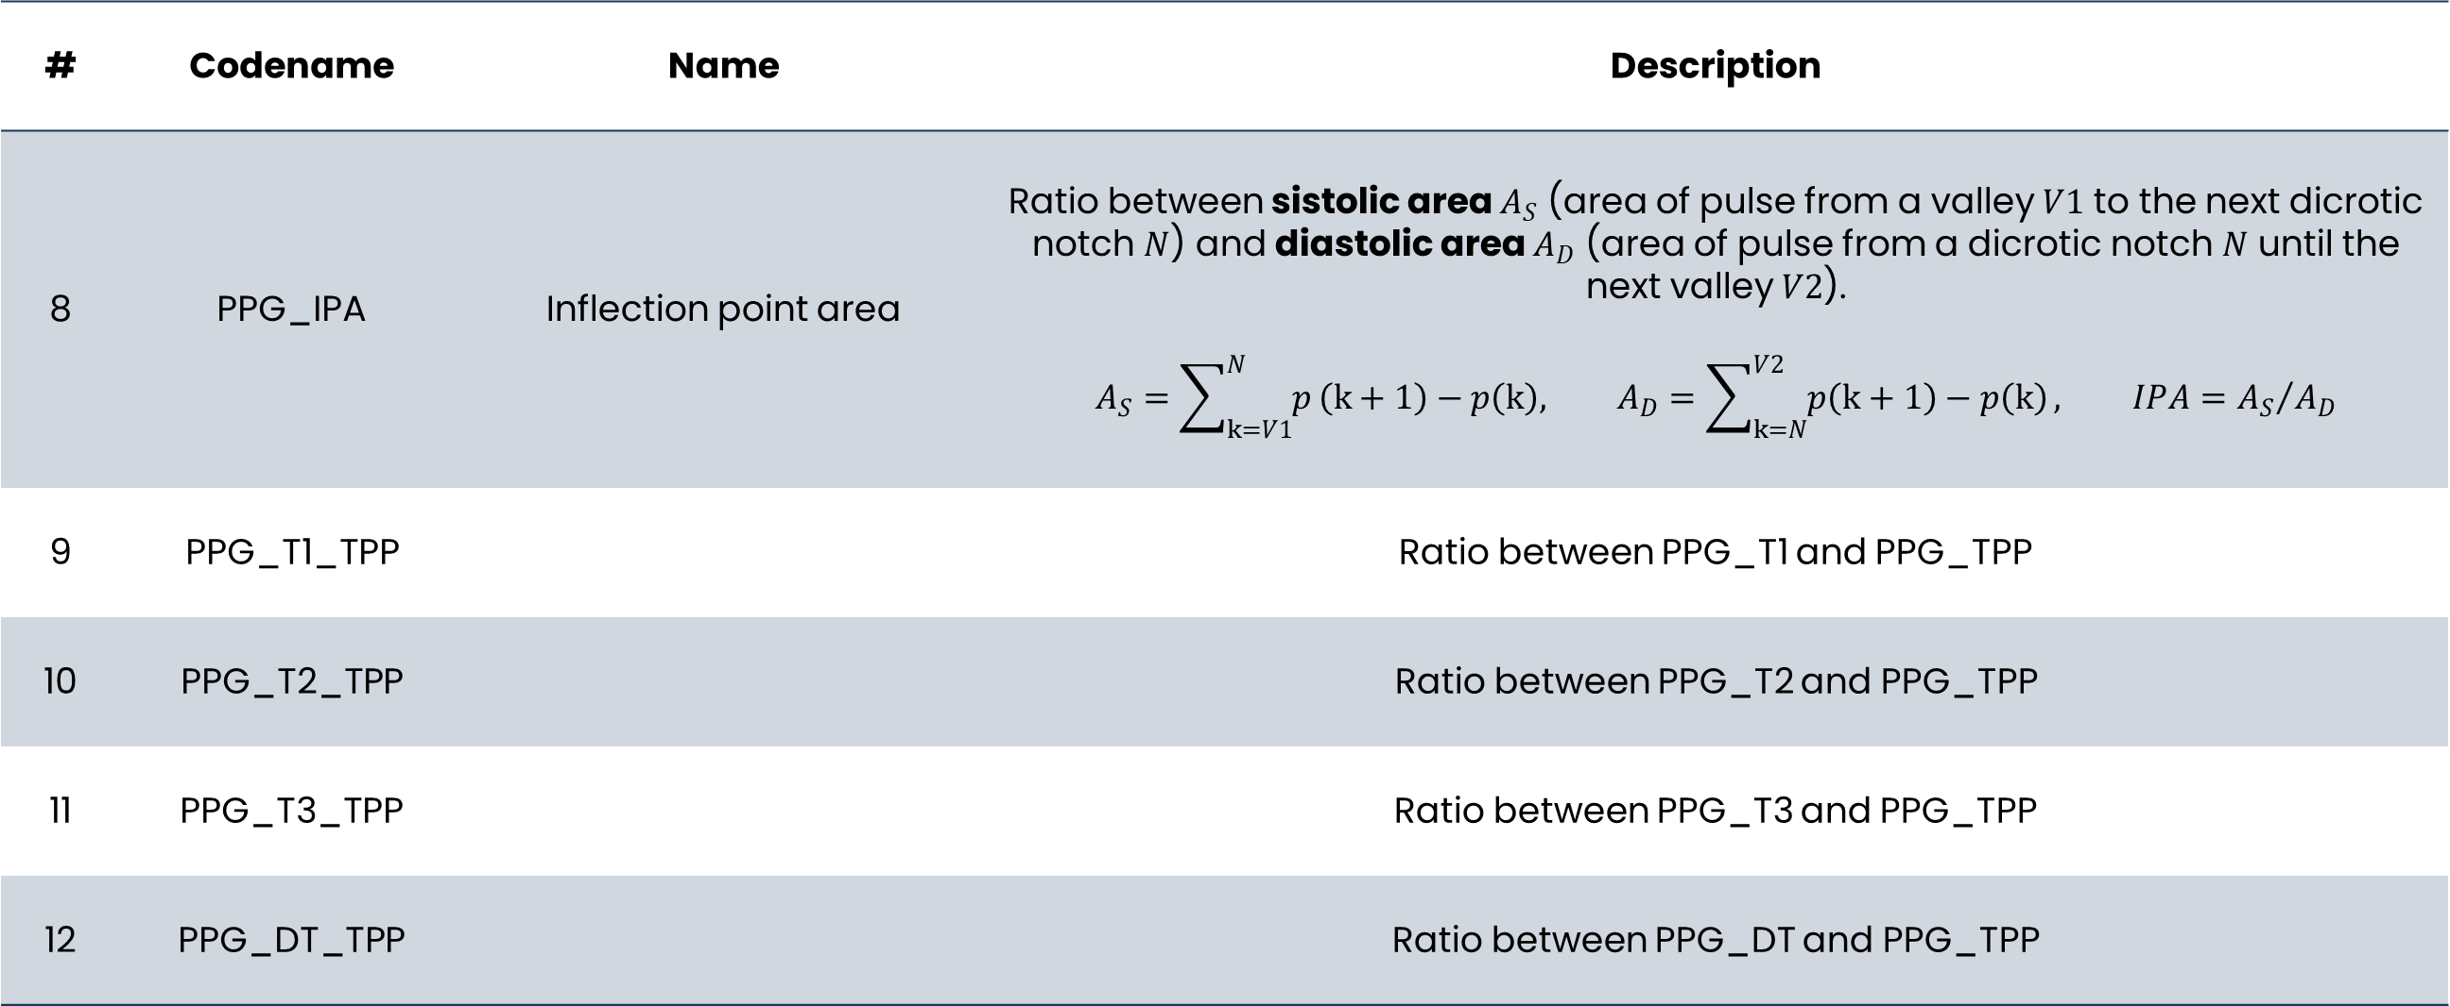
4
Feature analysis
Features
# | Codename | Name | Description
8 | PPG_IPA | Inflection point area | Ratio between sistolic area $A_{S}$ (area of pulse from a valley $V1$ to the next dicrotic notch $N$) and diastolic area $A_{D}$ (area of pulse from a dicrotic notch $N$ until the next valley $V2$). $$A_{S}=\sum_{k=V1}^{N}{p}\left(k+1\right)−p\left(k\right), A_{D}=\sum_{k=N}^{V2}{p\left(k+1\right)−p\left(k\right)}, IPA={A_{S}}/{A_{D}}$$
9 | PPG_T1_TPP |  | Ratio between PPG_T1 and PPG_TPP
10 | PPG_T2_TPP |  | Ratio between PPG_T2 and PPG_TPP
11 | PPG_T3_TPP |  | Ratio between PPG_T3 and PPG_TPP
12 | PPG_DT_TPP |  | Ratio between PPG_DT and PPG_TPP

Slide 39
4
Feature analysis
Features
# | Codename | Name | Description
13 | PPG_W25 | Pulse width at 25% | Pulse width (seconds) measured at 25% of maximum pulse’s amplitude
14 | PPG_W50 | Pulse width at 50% | Pulse width (seconds) measured at 50% of maximum pulse’s amplitude
15 | PPG_W75 | Pulse width at 75% | Pulse width (seconds) measured at 75% of maximum pulse’s amplitude
16 | PPG_W25_T1 |  | Ratio between PPG_W25 and PPG_T1
17 | PPG_W25_T2 |  | Ratio between PPG_W25 and PPG_T2
18 | PPG_W25_T3 |  | Ratio between PPG_W25 and PPG_T3
19 | PPG_W25_DT |  | Ratio between PPG_W25 and PPG_DT

Slide 40
4
Feature analysis
Features
# | Codename | Name | Description
20 | PPG_W25_TPI |  | Ratio between PPG_W25 and PPG_TPI
21 | PPG_W50_T1 |  | Ratio between PPG_W50 and PPG_T1
22 | PPG_W50_T2 |  | Ratio between PPG_W50 and PPG_T2
23 | PPG_W50_T3 |  | Ratio between PPG_W50 and PPG_T3
24 | PPG_W50_DT |  | Ratio between PPG_W50 and PPG_DT
25 | PPG_W50_TPI |  | Ratio between PPG_W50 and PPG_TPI

Slide 41
4
Feature analysis
Features
# | Codename | Name | Description
26 | PPG_W75_T1 |  | Ratio between PPG_W75 and PPG_T1
27 | PPG_W75_T2 |  | Ratio between PPG_W75 and PPG_T2
28 | PPG_W75_T3 |  | Ratio between PPG_W75 and PPG_T3
29 | PPG_W75_DT |  | Ratio between PPG_W75 and PPG_DT
30 | PPG_W75_TPI |  | Ratio between PPG_W75 and PPG_TPI

Slide 42
4
Feature analysis
Feature selection
Principal Components Analysis (PCA)
Translation of features to a new space by linear transformations
Resulting components ordered by explained variance
Which features contribute the most?
Loadings contain, for each component, the features ordered by weight for that component
How many features?
Only first 3 components considered
Only the features whose weight is over the 3rd quartile (PCA-Q3), for each component
Performed only on training set (80% of data)
23 out of 30 feature selected

Slide 43
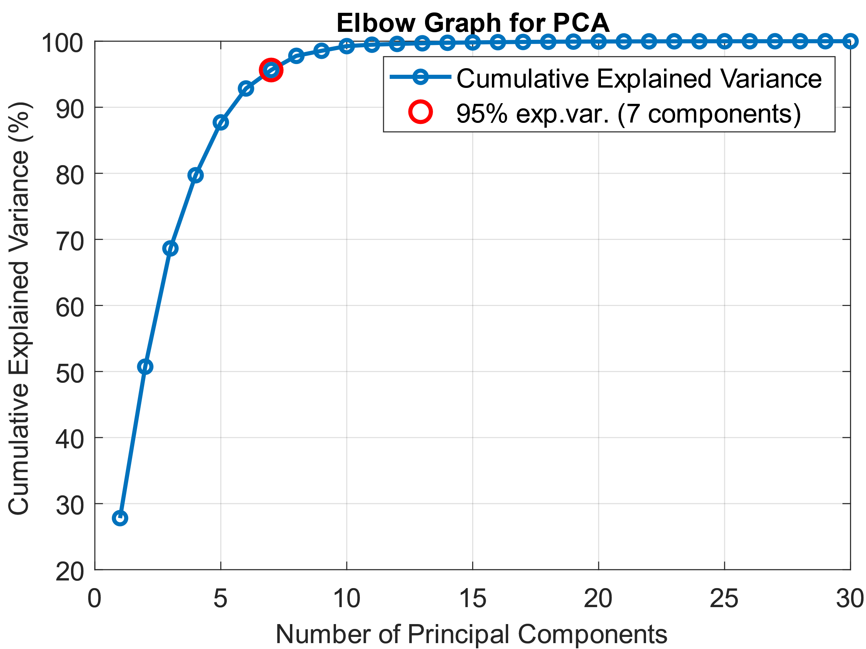
4
Feature analysis

Slide 44
Segmentation

Slide 45
5
Segmentation
Segmentation
Which is the best segment size?
With long segments, BP variations are lost
With short segments, signal imperfections can contaminate the result
Iterative selection
A model is chosen: linear SVM
A fixed overlap value is chosen: 25% of window size
Tests with different window sizes and errors of SBP as reference
Best: 1 minute
Longer segments saturate in errors
After one minute, BP can have slightly great variations

Slide 46
5
Segmentation

Slide 47
Experiments
Perform train/test with different models, settings and feature sets

Slide 48
6
Experiments
Common setup
90% train, 10% test
Min-max feature normalization
Perfomed on train and test set with data from train
Hyperparameter optimization
10-fold cross validation
1 minute windows
With overlap of 15 seconds (25%)
Split made grouping by patient

Slide 49
6
Experiments
Results - SBP
# | Model | Hyperparameters | Feature selection | Mean Absolute error | Mean Relative error
1 | Linear regression | None | No | 15.43 ± 10.48 | 12.98% ± 10.16%
2 | Lasso regression | Lamda=0.0003 | No | 15.44 ± 10.47 | 12.98% ± 10.15%
3 | Linear SVM | None | No | 16.13 ± 11.41 | 13.03% ± 9.38%
4 | Sigmoid SVM | C=20.668 Sigma=0.41565 Epsilon=5.38333 | No | 18.26 ± 13.88 | 15.32% ± 12.90%
5 | Sigmoid SVM | C=36.223 Sigma=0.57518 Epsilon=0.12434 | No | 18.62 ± 14.33 | 15.63% ± 13.22%

Slide 50
6
Experiments
Results - DBP
# | Model | Hyperparameters | Mean Absolute error | Mean Relative error
1 | Linear regression | None | 13.77 ± 8.75 | 20.87% ± 13.08%
2 | Lasso regression | Lamda=0.0002 | 13.77 ± 8.76 | 20.88% ± 13.08
3 | Linear SVM | None | 14.65 ± 9.86 | 21.51% ± 12.87%
4 | RBF SVM | C=403.29 Sigma=6.2842 Epsilon=0.20817 | 14.48 ± 8.89 | 21.89% ± 12.90%
5 | Sigmoid SVM | C=20.978 Sigma=0.4491 Epsilon=0.026472 | 14.60 ± 9.64 | 22.39% ± 14.94%

Slide 51
6
Experiments
Considerations
Unreliable predictors
Even the best models have large error
Features are significative
Otherwise the PCA would have yielded much less components
Is the dataset representative enough?
Try another train and test on the MIMIC-III dataset
MIMIC-III is a «revision» of MIMIC-II with new records

Slide 52
6
Experiments
Results - SBP
# | Model | Hyperparameters | Mean Absolute error | Mean Relative error
1 | Linear regression | None | 10.53 ± 8.62 | 7.68% ± 6.52
2 | Lasso regression | Lamda=0.0127 | 10.31 ± 8.52 | 7.50% ± 6.42
3 | Linear SVM | None | 11.02 ± 8.68 | 7.85% ± 6.08%
4 | RBF SVM | C=29.143 Sigma=1.3699 Epsilon=0.026496 | 12.23 ± 10.01 | 8.72% ± 7.22%
5 | Sigmoid SVM | C=29.168 Sigma=1.2021 Epsilon=0.072196 | 12.25 ± 10.01 | 8.73% ± 7.22%

Slide 53
6
Experiments
Results - DBP
# | Model | Hyperparameters | Mean Absolute error | Mean Relative error
1 | Linear regression | None | 8.25 ± 5.99 | 16.47% ± 14.79%
2 | Lasso regression | Lamda=0.0075 | 8.17 ± 5.95 | 16.37% ± 14.87
3 | Linear SVM | None | 8.70 ± 6.14 | 15.42% ± 15.16%
4 | RBF SVM | C=107.17 Sigma=3.2025 Epsilon=0.01458 | 9.19 ± 5.95 | 17.63% ± 13.78%
5 | Sigmoid SVM | C=67.498 Sigma=2.8537 Epsilon=2.6521 | 8.56 ± 5.95 | 16.52% ± 13.78%

Slide 54
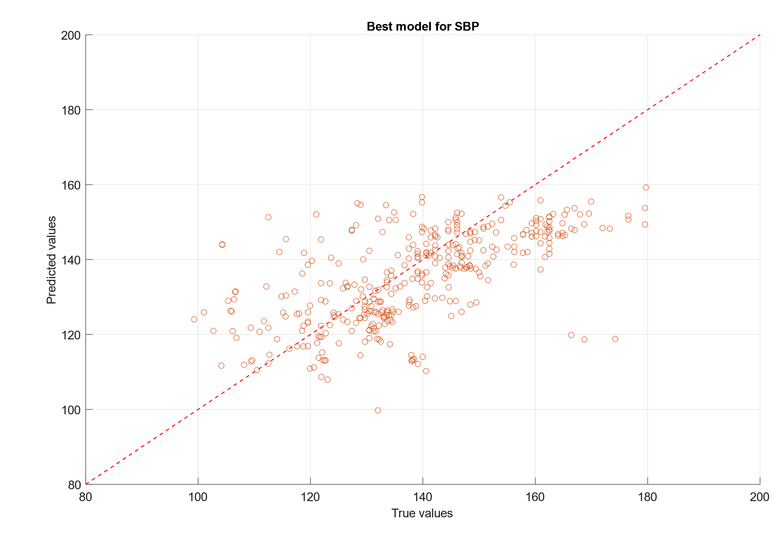
6
Experiments

Slide 55
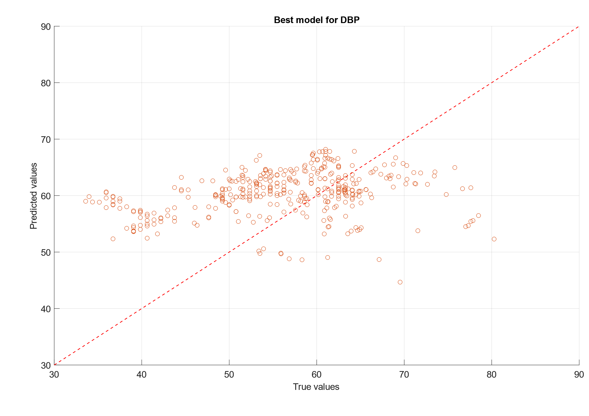
6
Experiments

Slide 56
6
Experiments
Considerations for improvements
Also ABP signal is imperfect
Oscillation between values of DBP and SBP, filtering may help
Signal selection only reduces the problem
Imbalanced dataset
Demographic features
Some papers []… uses age, sex, height, weight and BMI as features
MIMIC datasets provide only age and sex
Is MIMIC sufficient?
MIMIC contains only data from ICU patients, there may be a small variability
Certain values of SBP and DBP are prevalent over others, rebalancing by truncating

Slide 57
6
Experiments
ABP filtering
Wavelet decomposition
We expect the same bands of PPG
10 levels of Daubechies-8 DWT
Result is coherent
Actually same bands of PPG
for ABP, highest bands are just noise
The same filter of PPG can be used
Mean restoration
Store the mean of raw signal and add it back to the filtered signal

Slide 58
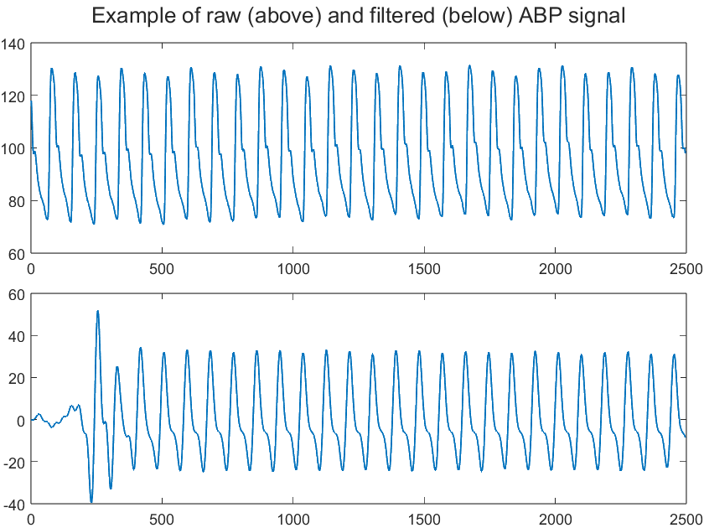
6
Experiments

Slide 59
6
Experiments
Rebalancing
Estimate distribution
For both SBP and DBP
Using histogram
Division in subranges
Number of bins of histogram
After some tries, 50 was the best
Subrange equalization
Compute minimum count c_min among subranges
Truncate data of each subrange to match c_min
Only on training set
Test set is to be considered «unknown» until the end

Slide 60
6
Experiments
The VitalDB dataset
MIMIC may be insufficient
Only patients in ICU -> less variability
No demographic features (only age and sex)
VitalDB dataset
Patients from non-cardiac surgery
Provides ABP, PPG, age, sex, weight, height and BMI
Adapting signals
Sampled at 500 Hz, decimated to 125 Hz
Workflow don’t change!

Slide 61
6
Experiments
Considerations on demographic features
Advantages
Theoretically better correlation with BP
Tailor the device on patient’s needs
Disadvantages
Need to update the device over time (age changes regularly; weight, height and BMI change without predictions)
Do we really need them? Yes
At numeric level, MAE sinks by 2
At graphic level, the relation is certain linear following the ideal model (even if with large variability)

Slide 62
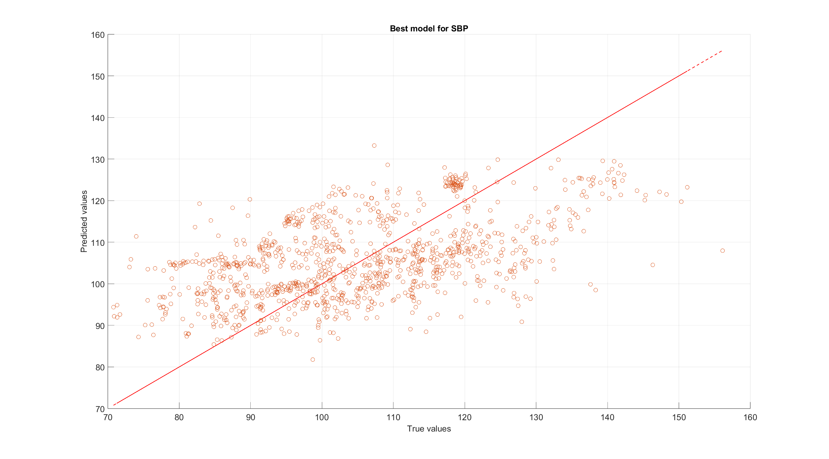
6
Experiments
VitalDB: SBP best model (no demographic features)

Slide 63
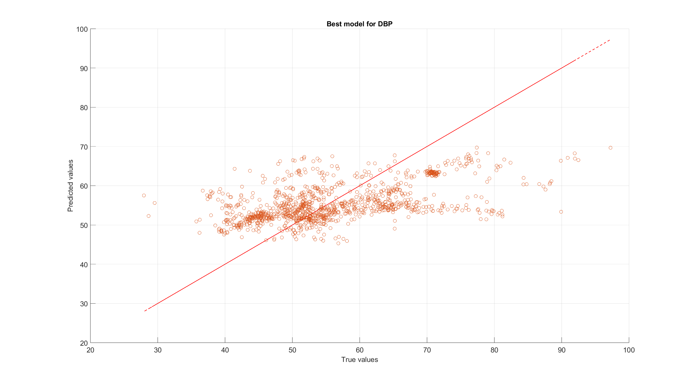
6
Experiments
VitalDB: DBP best model (no demographic features)

Slide 64
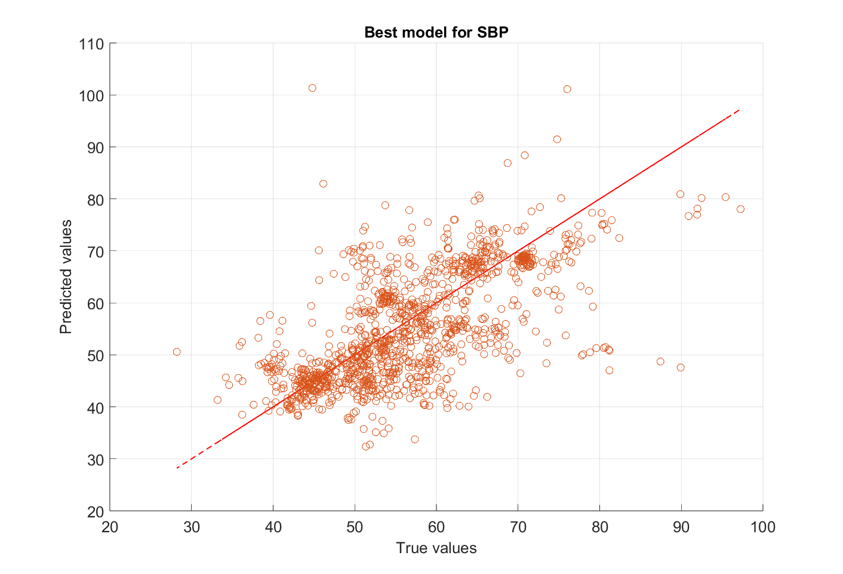
6
Experiments
VitalDB: SBP best model (with demographic features)

Slide 65
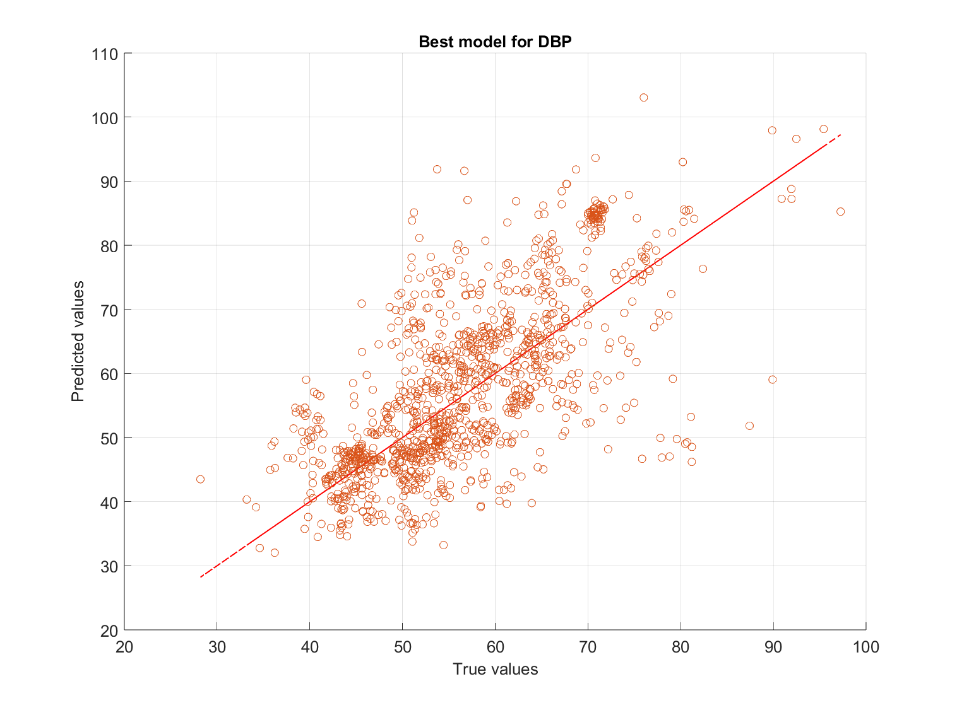
6
Experiments
VitalDB: DBP best model (with demographic features)

Slide 66
6
Experiments
Errors report
Model | Absolute error (std) | Mean Relative error (std) | Hyperparameters
SBP (with demographics), linear regression | 6.32 (6.04) | 11.14% (10.65%) | Ridge regularization Lambda=1.68875758704911e-08
DBP (with demographics), linear regression | 6.63 (5.74) | 12.27% (11.36%) | Ridge regression Lambda=5.69990988504337e-08
SBP (no demographics), linear regression | 12.19 (8.83) | 11.79% (9.05%) | Ridge regularization Lambda=8.24754638825682
DBP (no demographics), linear regression | 7.78 (5.95) | 14.15% (11.30%) | Ridge regularization Lambda=0.000131760236528884

Slide 67
References

Slide 68
References
[1] N. Faris Ali and M. Atef, ‘An efficient hybrid LSTM-ANN joint classification-regression model for PPG based blood pressure monitoring’, Biomedical Signal Processing and Control, vol. 84, p. 104782, Jul. 2023, doi: 10.1016/j.bspc.2023.104782.
[2] S. Baek, J. Jang, and S. Yoon, ‘End-to-End Blood Pressure Prediction via Fully Convolutional Networks’, IEEE Access, vol. 7, pp. 185458–185468, 2019, doi: 10.1109/ACCESS.2019.2960844.
[3] S. Chen, Z. Ji, H. Wu, and Y. Xu, ‘A Non-Invasive Continuous Blood Pressure Estimation Approach Based on Machine Learning’, Sensors, vol. 19, no. 11, p. 2585, Jun. 2019, doi: 10.3390/s19112585.
[4] A. D. Choudhury, R. Banerjee, A. Sinha, and S. Kundu, ‘Estimating blood pressure using Windkessel model on photoplethysmogram’, in 2014 36th Annual International Conference of the IEEE Engineering in Medicine and Biology Society, Chicago, IL: IEEE, Aug. 2014, pp. 4567–4570. doi: 10.1109/EMBC.2014.6944640.
[5] M. H. Chowdhury et al., ‘Estimating Blood Pressure from the Photoplethysmogram Signal and Demographic Features Using Machine Learning Techniques’, Sensors, vol. 20, no. 11, p. 3127, Jun. 2020, doi: 10.3390/s20113127.
[6] J. Dey, A. Gaurav, and V. N. Tiwari, ‘InstaBP: Cuff-less Blood Pressure Monitoring on Smartphone using Single PPG Sensor’, in 2018 40th Annual International Conference of the IEEE Engineering in Medicine and Biology Society (EMBC), Honolulu, HI: IEEE, Jul. 2018, pp. 5002–5005. doi: 10.1109/EMBC.2018.8513189.

Slide 69
References
[7] K. Duan, Z. Qian, M. Atef, and G. Wang, ‘A feature exploration methodology for learning based cuffless blood pressure measurement using photoplethysmography’, in 2016 38th Annual International Conference of the IEEE Engineering in Medicine and Biology Society (EMBC), Orlando, FL, USA: IEEE, Aug. 2016, pp. 6385–6388. doi: 10.1109/EMBC.2016.7592189.
[8] C. El-Hajj and P. Kyriacou, ‘Deep learning models for cuffless blood pressure monitoring from PPG signals using attention mechanism’, Biomedical Signal Processing and Control, vol. 65, p. 102301, Mar. 2021, doi: 10.1016/j.bspc.2020.102301.
[9] M. Kachuee, M. M. Kiani, H. Mohammadzade, and M. Shabany, ‘Cuff-less high-accuracy calibration-free blood pressure estimation using pulse transit time’, in 2015 IEEE International Symposium on Circuits and Systems (ISCAS), Lisbon, Portugal: IEEE, May 2015, pp. 1006–1009. doi: 10.1109/ISCAS.2015.7168806.
[10] S. C. Gao, P. Wittek, L. Zhao, and W. J. Jiang, ‘Data-driven estimation of blood pressure using photoplethysmographic signals’, in 2016 38th Annual International Conference of the IEEE Engineering in Medicine and Biology Society (EMBC), Orlando, FL, USA: IEEE, Aug. 2016, pp. 766–769. doi: 10.1109/EMBC.2016.7590814.
[11] A. Gaurav, M. Maheedhar, V. N. Tiwari, and R. Narayanan, ‘Cuff-less PPG based continuous blood pressure monitoring — A smartphone based approach’, in 2016 38th Annual International Conference of the IEEE Engineering in Medicine and Biology Society (EMBC), Orlando, FL, USA: IEEE, Aug. 2016, pp. 607–610. doi: 10.1109/EMBC.2016.7590775.

Slide 70
References
[12] S. S. Thomas, V. Nathan, C. Zong, K. Soundarapandian, X. Shi, and R. Jafari, ‘BioWatch: A Noninvasive Wrist-Based Blood Pressure Monitor That Incorporates Training Techniques for Posture and Subject Variability’, IEEE J. Biomed. Health Inform., vol. 20, no. 5, pp. 1291–1300, Sep. 2016, doi: 10.1109/JBHI.2015.2458779.
[13] M. Liu, L.-M. Po, and H. Fu, ‘Cuffless Blood Pressure Estimation Based on Photoplethysmography Signal and Its Second Derivative’, IJCTE, vol. 9, no. 3, pp. 202–206, 2017, doi: 10.7763/IJCTE.2017.V9.1138.
[14] K. Song, K. Chung, and J.-H. Chang, ‘Cuffless Deep Learning-Based Blood Pressure Estimation for Smart Wristwatches’, IEEE Trans. Instrum. Meas., vol. 69, no. 7, pp. 4292–4302, Jul. 2020, doi: 10.1109/TIM.2019.2947103.
[15] K. N. G. Priyanka et al., ‘Estimating Blood Pressure via Artificial Neural Networks Based on Measured Photoplethysmography Waveforms’, in 2018 IEEE SENSORS, New Delhi: IEEE, Oct. 2018, pp. 1–4. doi: 10.1109/ICSENS.2018.8589796.
[16] P. Su, X.-R. Ding, Y.-T. Zhang, J. Liu, F. Miao, and N. Zhao, ‘Long-term blood pressure prediction with deep recurrent neural networks’, in 2018 IEEE EMBS International Conference on Biomedical & Health Informatics (BHI), Las Vegas, NV, USA: IEEE, Mar. 2018, pp. 323–328. doi: 10.1109/BHI.2018.8333434.
[17] N. F. Ali, M. Hussein, F. Awwad, and M. Atef, ‘Convolutional Autoencoder for Real-Time PPG Based Blood Pressure Monitoring Using TinyML’, in 2023 International Conference on Microelectronics (ICM), Abu Dhabi, United Arab Emirates: IEEE, Dec. 2023, pp. 41–45. doi: 10.1109/ICM60448.2023.10378901.

Slide 71
References
[18] B. C. Casadei, A. Gumiero, G. Tantillo, L. Della Torre, and G. Olmo, ‘Systolic Blood Pressure Estimation from PPG Signal Using ANN’, Electronics, vol. 11, no. 18, p. 2909, Sep. 2022, doi: 10.3390/electronics11182909.
[19] K. Ahmed and M. Hassan, ‘tinyCare: A tinyML-based Low-Cost Continuous Blood Pressure Estimation on the Extreme Edge’, in 2022 IEEE 10th International Conference on Healthcare Informatics (ICHI), Rochester, MN, USA: IEEE, Jun. 2022, pp. 264–275. doi: 10.1109/ICHI54592.2022.00047.
[20] B. Tóth, S. Torma, Á. Nagy, and L. Szegletes, ‘Deep Learning-Based Blood Pressure Measurement on a Low-Power Microcontroller’, in 2023 14th IEEE International Conference on Cognitive Infocommunications (CogInfoCom), Budapest, Hungary: IEEE, Sep. 2023, pp. 000117–000122. doi: 10.1109/CogInfoCom59411.2023.10397510.
[21] D. Agro et al., ‘PPG embedded system for blood pressure monitoring’, in 2014 AEIT Annual Conference - From Research to Industry: The Need for a More Effective Technology Transfer (AEIT), Trieste: IEEE, Sep. 2014, pp. 1–6. doi: 10.1109/AEIT.2014.7002012.
[22] V. P. Rachim, S. Kang, J.-H. Baek, and S.-M. Park, ‘Unobtrusive, Cuffless Blood Pressure Monitoring Using a Soft Polymer Sensor Array With Flexible Hybrid Electronics’, IEEE Sensors J., vol. 21, no. 8, pp. 10132–10142, Apr. 2021, doi: 10.1109/JSEN.2021.3059864.

Slide 72
References
[23] Q. Wu et al., ‘An Ambulatory Blood Pressure Monitoring System Based on the Uncalibrated Steps of the Wrist’, in 2019 12th International Congress on Image and Signal Processing, BioMedical Engineering and Informatics (CISP-BMEI), Suzhou, China: IEEE, Oct. 2019, pp. 1–6. doi: 10.1109/CISP-BMEI48845.2019.8966011.
[24] M. Kachuee, M. M. Kiani, H. Mohammadzade, and M. Shabany, ‘Cuffless Blood Pressure Estimation Algorithms for Continuous Health-Care Monitoring’, IEEE Trans. Biomed. Eng., vol. 64, no. 4, pp. 859–869, Apr. 2017, doi: 10.1109/TBME.2016.2580904.
[25] M. Saeed et al., ‘Multiparameter Intelligent Monitoring in Intensive Care II: A public-access intensive care unit database*’:, Critical Care Medicine, vol. 39, no. 5, pp. 952–960, May 2011, doi: 10.1097/CCM.0b013e31820a92c6.
[26] A. L. Goldberger et al., ‘PhysioBank, PhysioToolkit, and PhysioNet: Components of a New Research Resource for Complex Physiologic Signals’, Circulation, vol. 101, no. 23, Jun. 2000, doi: 10.1161/01.CIR.101.23.e215.
[27] T. Foss, E. Stensrud, B. Kitchenham, and I. Myrtveit, ‘A simulation study of the model evaluation criterion mmre’, IIEEE Trans. Software Eng., vol. 29, no. 11, pp. 985–995, Nov. 2003, doi: 10.1109/TSE.2003.1245300.

